Slide 1
DOCKET
By Siddharth Dahiya & Yash Dahiya

Slide 2
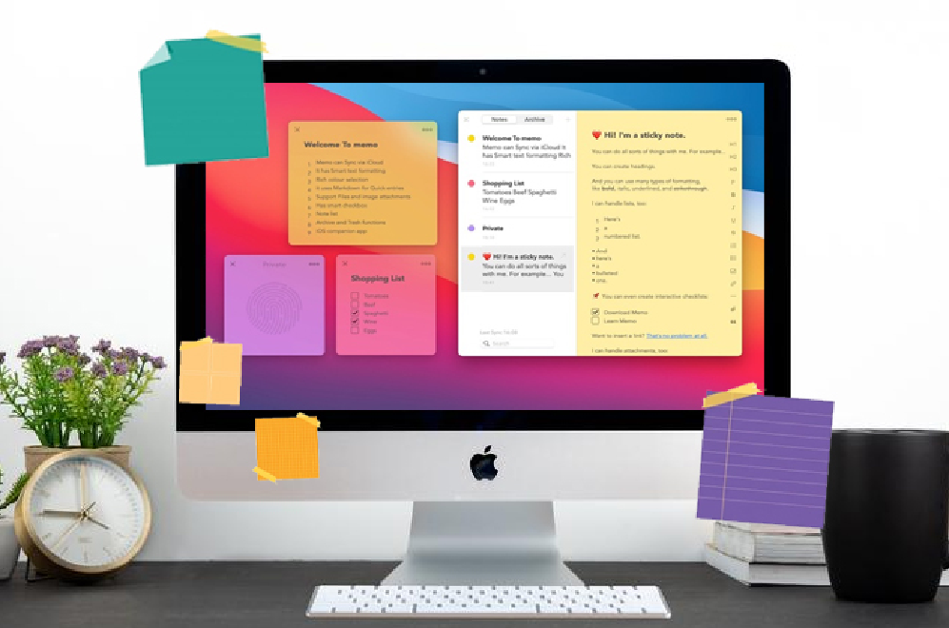
About Docket
Docket is practical for people who like to organize, plan, or do something later but forget about it later. It functions as a simple checklist (aka sticky notes), preferred by most organizations for neat and orderly work.
Since it also serves as a reminder for deadlines. Docket helps users manage their tasks while online browsing, researching, studying, shopping, and other activities.

Slide 3
Inspiration for Docket
Docket will benefit most web users who like to plan, organise or do something later and not forget about it.
People use this concept frequently but mostly by writing it down. They will save time, space and energy by using Docket.
It is based on usage of sticky notes.

Slide 4

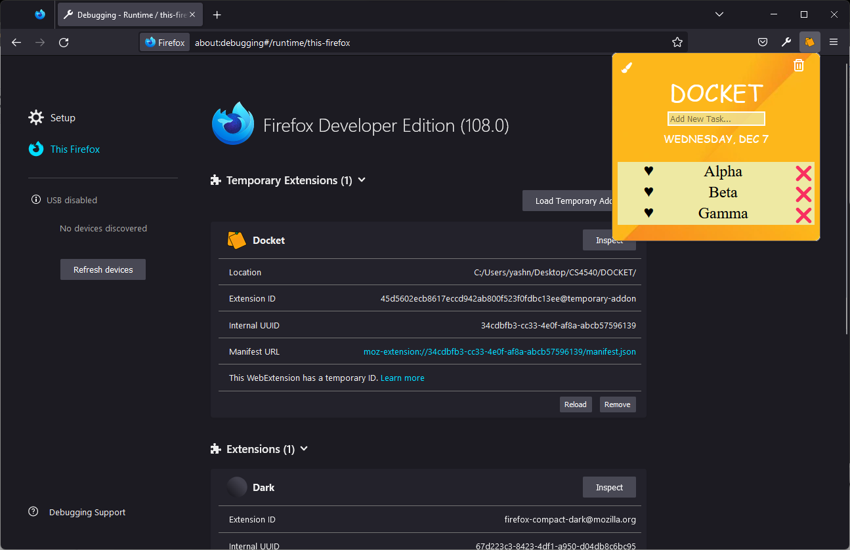

Docket View

Slide 5
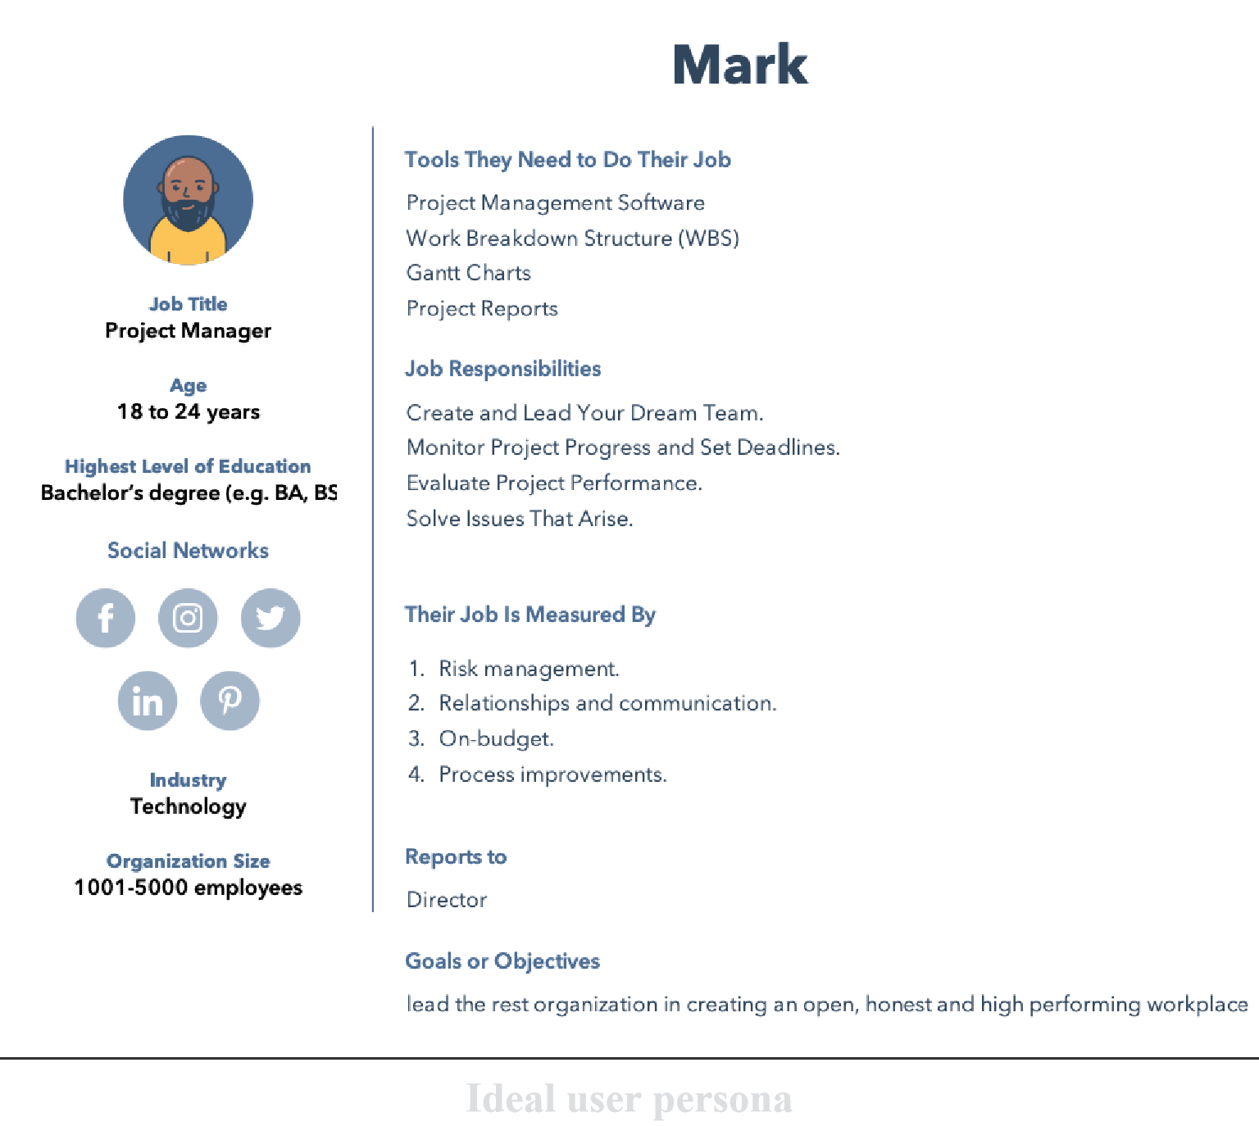
User Persona
Meet Mark!
Learn how docket is helpful to Mark.

Slide 6
How will Docket help mark?
Motivates the team
Improves Productivity
Delegating Tasks
Analysing work
Help save Nature

Slide 7
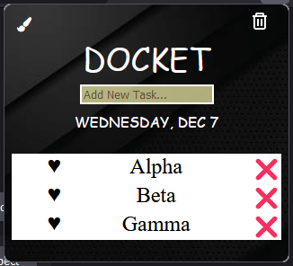
Building Phase
Design and requirements
This first step was to design the architecture and research the workable requirements of a to-do list from a similar API or extension.It tells us about the required permissions, structure of a to-do list extension, working API knowledge and management of browser site/tabs.

Slide 8
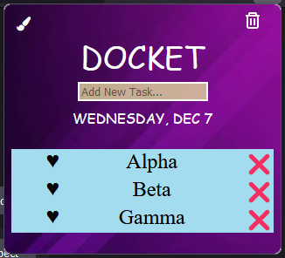
Building Phase
Code and Development
This phase was all about working on the prototype extension development. We applied the design knowledge to create an extension model that works with all functionality we mentioned.

Slide 9
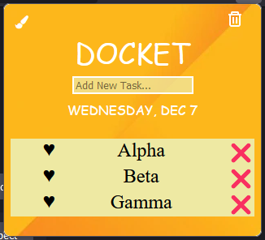
Building Phase
Customisation and Appearance
We worked on the CSS and styles of extension to make it fancy and easier to use. We finally had the end product with a simple appearance that easy to use and compatible with most websites.

Slide 10
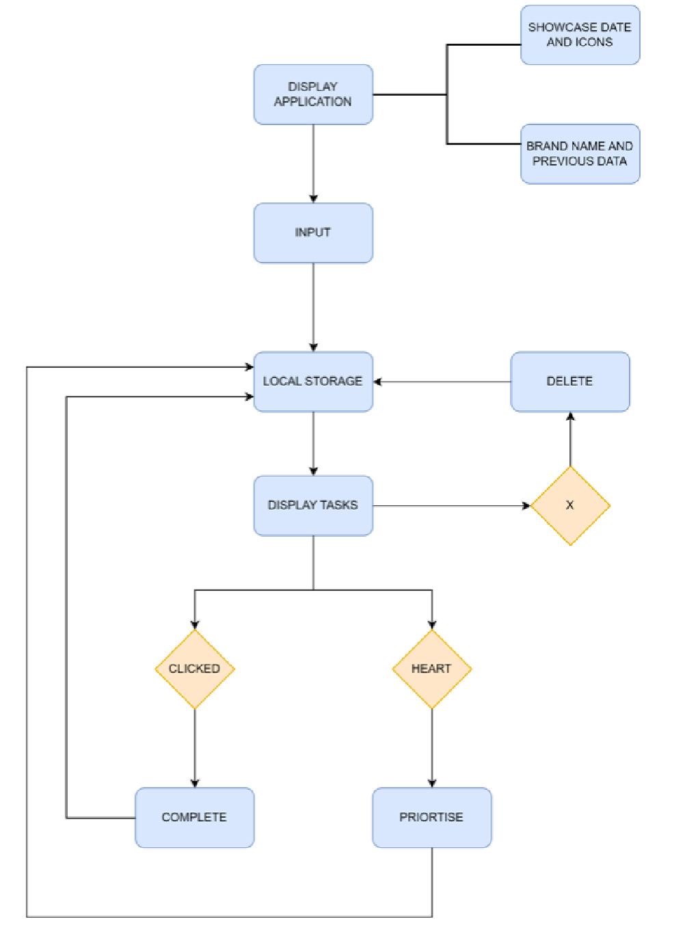
System
Architecture

Slide 11

Functionalities of Docket
Input and Adding Tasks.
Checking or Highlighting Completion of Tasks.
Remove completed/unwanted Tasks.
Remove all button.
Priority Enabled Tasks are Saved.
Different color schemes.

Slide 12
Versions of Docket

Slide 13
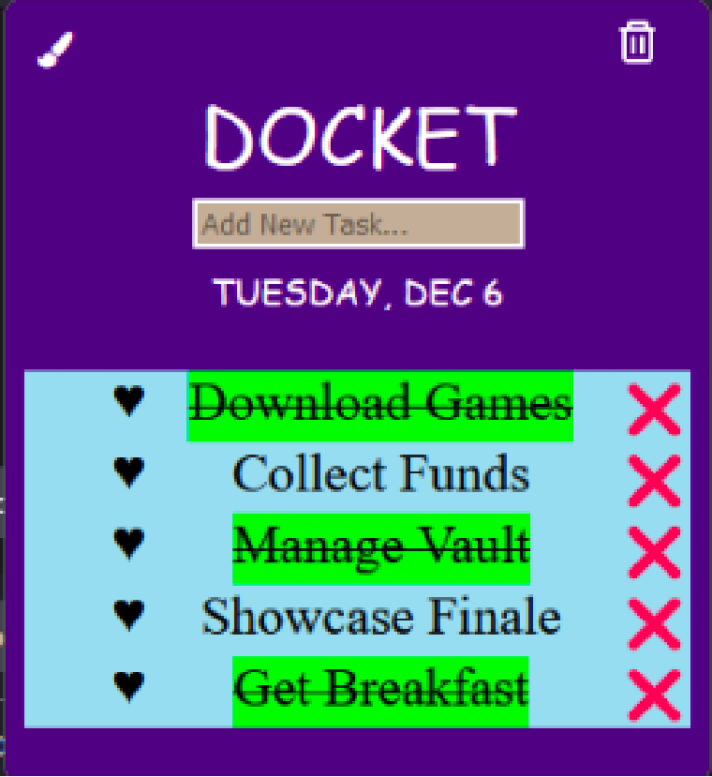
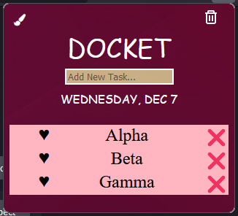
Version 0.1 - 0.2.5
Version 0.3+
Built Base files, Added Functionality, Worked on Storage and Keys. Styled simple.
Fine Tuned Parameters, Added More Functionality such as Priority. Worked on CSS and UI/UX.

Slide 14
Difficulties during Build Phase
Storage Doesn’t Worked with EDIT.
Scrapped Some Functionality Due to Time Constraints and Schedule Constraints.
Drag and Drop was messing the ID numbers of Storage.
Notifications and Alerts were scrapped due to them being bugged to popup bar.

Slide 15
Docket Strength and Weakness
Strengths
Simple and easy to use.
Efficient design which is user friendly.
Improves Productivity.
Weakness
Temporary Storage.

Slide 16

Technical Insights
Local Storage Working of Browsers.
Notifications and Access Requirements.
Dynamic Styling and JS.
Git Knowledge.

Slide 17
Live Demo
For more information refer to the below:
https://github.com/yashdahiya0/CS4540-Mozilla-Project-Group-7

